Slide 1


OCP 11 Part 1 [1Z0-819]
Dr.-Ing Mohamed Amine Mezghich
Associate Professor at ENSI, CEO of Smart IT Partner
JAVA/J2EE Certified Trainer
ma.mezghich@smart-it-partner.com
amine.mezghich@ensi-uma.tn

Slide 2
Chapter 3 : Core Java APIs
OCA EXAM OBJECTIVES COVERED IN THIS CHAPTER: ✓ Using Operators and Decision Constructs ■ Test equality between Strings and other objects using == and equals() ✓ Creating and Using Arrays ■ Declare, instantiate, initialize and use a one-dimensional array ■ Declare, instantiate, initialize and use a multi-dimensional array

Slide 3
Chapter 3 : Core Java APIs
OCA EXAM OBJECTIVES COVERED IN THIS CHAPTER: Working with Selected classes from the Java API ■ Creating and manipulating Strings ■ Manipulate data using the StringBuilder class and its methods ■ Declare and use an ArrayList of a given type ■ Create and manipulate calendar data using classes from java. time.LocalDateTime, java.time.LocalDate, java.time.LocalTime, java.time.format.DateTimeFormatter, java.time.Period ✓ Working with Java Data Types ■ Develop code that uses wrapper classes such as Boolean, Double, and Integer.

Slide 4
1-Creating and Manipulating Strings
The String class is such a fundamental class that you’d be hard-pressed to write code without it. After all, you can’t even write a main() method without using the String class. A string is basically a sequence of characters; here’s an example: String name = "Fluffy" As you learned in Chapter 1, “Java Building Blocks,” this is an example of a reference type. You also learned that reference types are created using the new keyword. Wait a minute. Something is missing from the previous example: it doesn’t have new in it! In Java, these two snippets both create a String: String name = "Fluffy"; String name = new String("Fluffy");

Slide 5
1-Creating and Manipulating Strings
Both give you a reference variable of type name pointing to the String object "Fluffy". They are subtly different, as you’ll see in the section “String Pool,” later in this chapter. For now, just remember that the String class is special and doesn’t need to be instantiated with new. In this section, we’ll look at concatenation, immutability, the string pool, common methods, and method chaining.

Slide 6
1-Creating and Manipulating Strings
1- Concatenation Placing one String before the other String and combining them together is called string concatenation. The OCA exam creators like string concatenation because the + operator can be used in two ways within the same line of code. There aren’t a lot of rules to know for this, but you have to know them well: 1. If both operands are numeric, + means numeric addition. 2. If either operand is a String, + means concatenation. 3. The expression is evaluated left to right.

Slide 7
1-Creating and Manipulating Strings
1- Concatenation Now let’s look at some examples: System.out.println(1 + 2); // 3 System.out.println("a" + "b"); // ab System.out.println("a" + "b" + 3); // ab3 System.out.println(1 + 2 + "c"); // 3c

Slide 8
1-Creating and Manipulating Strings
1- Concatenation int three = 3; String four = "4"; System.out.println(1 + 2 + three + four); ?

Slide 9
1-Creating and Manipulating Strings
1- Concatenation There is only one more thing to know about concatenation, but it is an easy one. In this example, you just have to remember what += does. s += "2" means the same thing as s = s + "2". 4: String s = "1"; // s currently holds "1" 5: s += "2"; // s currently holds "12" 6: s += 3; // s currently holds "123" 7: System.out.println(s); // 123

Slide 10
1-Creating and Manipulating Strings
2- Immutability Once a String object is created, it is not allowed to change. It cannot be made larger or smaller, and you cannot change one of the characters inside it. You can think of a string as a storage box you have perfectly full and whose sides can’t bulge. There’s no way to add objects, nor can you replace objects without disturbing the entire arrangement. The trade-off for the optimal packing is zero ﬂexibility. Mutable is another word for changeable. Immutable is the opposite—an object that can’t be changed once it’s created. On the OCA exam, you need to know that String is immutable.

Slide 11
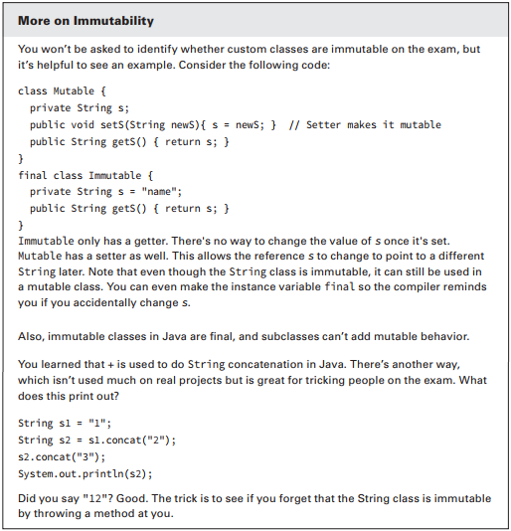
1-Creating and Manipulating Strings
2- Immutability

Slide 12
1-Creating and Manipulating Strings
3- The String Pool Since strings are everywhere in Java, they use up a lot of memory. In some production applications, they can use up 25–40 percent of the memory in the entire program. Java realizes that many strings repeat in the program and solves this issue by reusing common ones. The string pool, also known as the intern pool, is a location in the Java virtual machine (JVM) that collects all these strings. The string pool contains literal values that appear in your program. For example, “name” is a literal and therefore goes into the string pool.
myObject.toString() is a string but not a literal, so it does not go into the string pool. Strings not in the string pool are garbage collected just like any other object

Slide 13
1-Creating and Manipulating Strings
3- The String Pool Remember back when we said these two lines are subtly different? String name = "Fluffy"; String name = new String("Fluffy"); The former says to use the string pool normally. The second says “No, JVM. I really don’t want you to use the string pool. Please create a new object for me even though it is less efficient.” When you write programs, you wouldn’t want to do this. For the exam, you need to know that it is allowed.

Slide 14
1-Creating and Manipulating Strings
4- Important String Methods The String class has dozens of methods. Luckily, you need to know only a handful for the exam. The exam creators pick most of the methods developers use in the real world. For all these methods, you need to remember that a string is a sequence of characters and Java counts from 0 when indexed. Figure 3.1 shows how each character in the string "animals" is indexed.

Slide 15
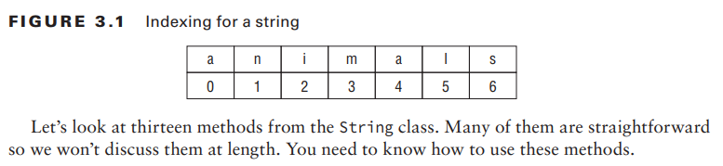
1-Creating and Manipulating Strings
4- Important String Methods

Slide 16
1-Creating and Manipulating Strings
4- Important String Methods

Slide 17
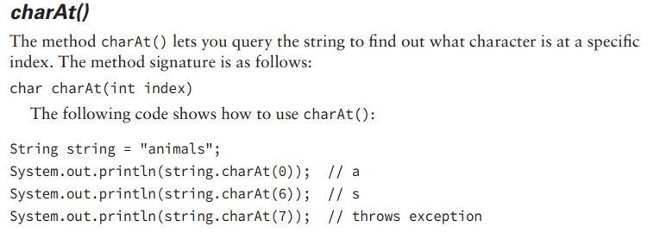
1-Creating and Manipulating Strings
4- Important String Methods

Slide 18
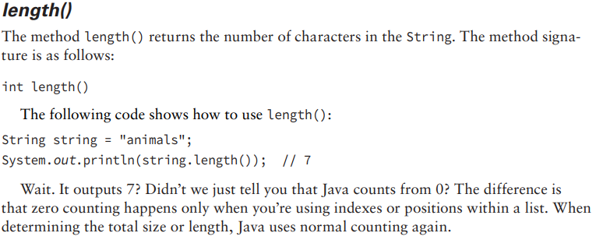
1-Creating and Manipulating Strings
4- Important String Methods

Slide 19
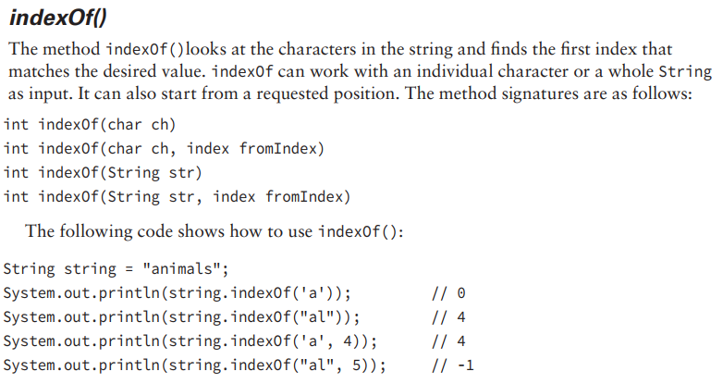
1-Creating and Manipulating Strings
4- Important String Methods

Slide 20
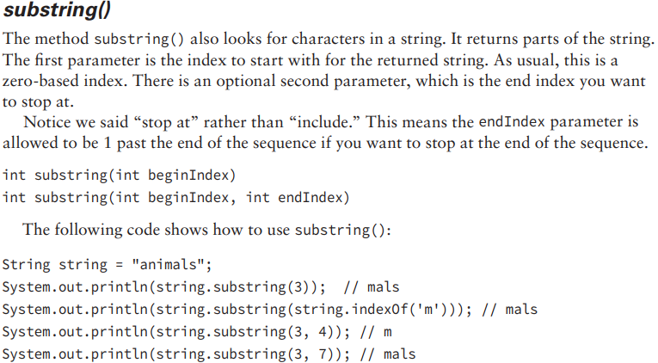
1-Creating and Manipulating Strings
4- Important String Methods

Slide 21
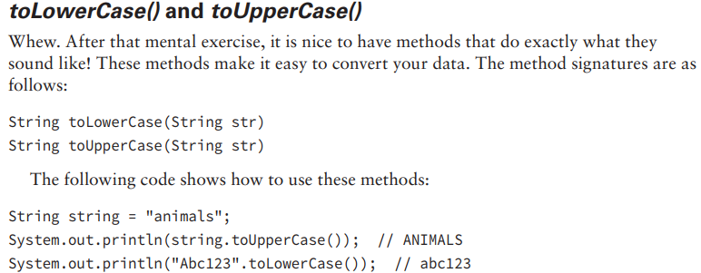
1-Creating and Manipulating Strings
4- Important String Methods

Slide 22
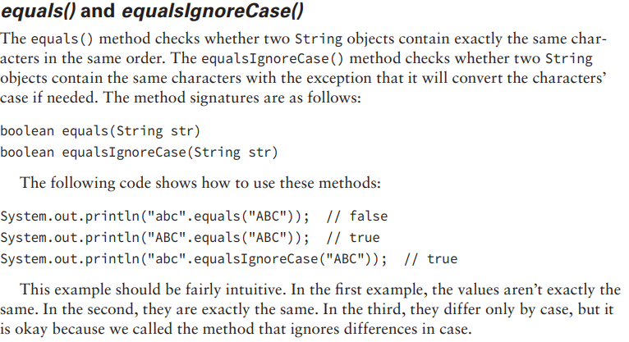
1-Creating and Manipulating Strings
4- Important String Methods

Slide 23
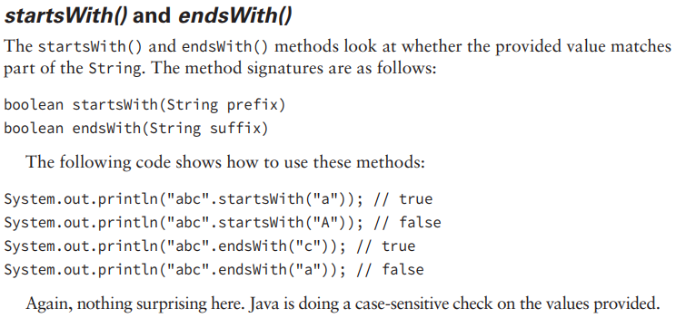
1-Creating and Manipulating Strings
4- Important String Methods

Slide 24
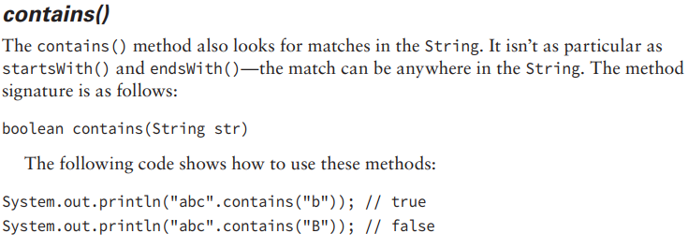
1-Creating and Manipulating Strings
4- Important String Methods

Slide 25
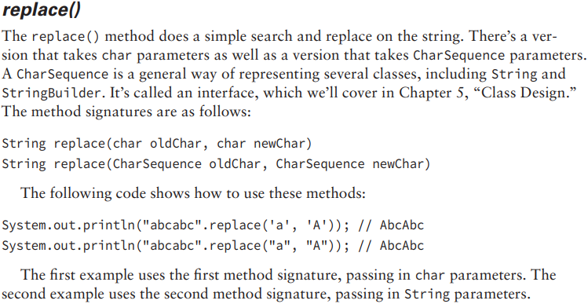
1-Creating and Manipulating Strings
4- Important String Methods

Slide 26
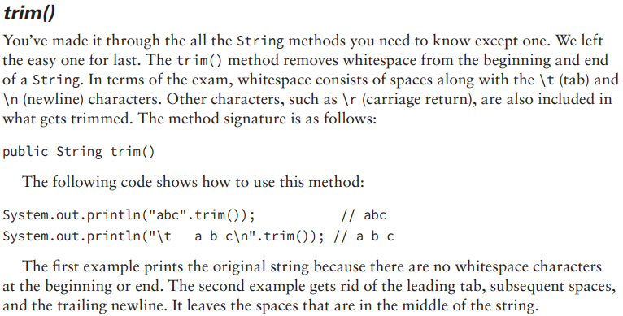
1-Creating and Manipulating Strings
4- Important String Methods

Slide 27
1-Creating and Manipulating Strings
5- Method Chaining It is common to call multiple methods on the same String, as shown here: String start = "AniMaL "; String trimmed = start.trim(); // "AniMaL" String lowercase = trimmed.toLowerCase(); // "animal" String result = lowercase.replace(''an'', ''An''); // "Animal" System.out.println(result);

Slide 28
1-Creating and Manipulating Strings
5- Method Chaining This is just a series of String methods. Each time one is called, the returned value is put in a new variable. There are four String values along the way, and Animal is output. However, on the exam there is a tendency to cram as much code as possible into a small space. You’ll see code using a technique called method chaining. Here’s an example: String result = "AniMaL ".trim().toLowerCase().replace(‘’an‘’, ‘’An‘’); System.out.println(result);

Slide 29
1-Creating and Manipulating Strings
5- Method Chaining This code is equivalent to the previous example. It also creates four String objects and outputs Animal. To read code that uses method chaining, start at the left and evaluate the first method. Then call the next method on the returned value of the first method. Keep going until you get to the semicolon. Remember that String is immutable. What do you think the result of this code is? 5: String a = "abc"; 6: String b = a.toUpperCase(); 7: b = b.replace("B", "2").replace('C', '3'); 8: System.out.println("a=" + a); 9: System.out.println("b=" + b);

Slide 30
2-Using the StringBuilder Class
A small program can create a lot of String objects very quickly. For example, how many do you think this piece of code creates? 10: String alpha = ""; 11: for(char current = 'a'; current <= 'z'; current++) 12: alpha += current; 13: System.out.println(alpha); The empty String on line 10 is instantiated, and then line 12 appends an "a". However, because the String object is immutable, a new String object is assigned to alpha and the “” object becomes eligible for garbage collection. The next time through the loop, alpha is assigned a new String object, "ab", and the "a" object becomes eligible for garbage collection. The next iteration assigns alpha to "abc" and the "ab" object becomes eligible for garbage collection, and so on. This sequence of events continues, and after 26 iterations through the loop, a total of 27 objects are instantiated, most of which are immediately eligible for garbage collection.

Slide 31
2-Using the StringBuilder Class
This is very ineffcient. Luckily, Java has a solution. The StringBuilder class creates a String without storing all those interim String values. Unlike the String class, StringBuilder is not immutable. 15: StringBuilder alpha = new StringBuilder(); 16: for(char current = 'a'; current <= 'z'; current++) 17: alpha.append(current); 18: System.out.println(alpha);

Slide 32
2-Using the StringBuilder Class
1-Mutability and Chaining When we chained String method calls, the result was a new String with the answer. Chaining StringBuilder objects doesn’t work this way. Instead, the StringBuilder changes its own state and returns a reference to itself! Let’s look at an example to make this clearer: 4: StringBuilder sb = new StringBuilder("start"); 5: sb.append("+middle"); // sb = "start+middle" 6: StringBuilder same = sb.append("+end"); // "start+middle+end"

Slide 33
2-Using the StringBuilder Class
1-Mutability and Chaining What do you think this example prints? 4: StringBuilder a = new StringBuilder("abc"); 5: StringBuilder b = a.append("de"); 6: b = b.append("f").append("g"); 7: System.out.println("a=" + a); 8: System.out.println("b=" + b); Did you say both print "abcdefg"? Good.

Slide 34
2-Using the StringBuilder Class
2-Creating a StringBuilder There are three ways to construct a StringBuilder: StringBuilder sb1 = new StringBuilder(); StringBuilder sb2 = new StringBuilder("animal"); StringBuilder sb3 = new StringBuilder(10); The first says to create a StringBuilder containing an empty sequence of characters and assign sb1 to point to it. The second says to create a StringBuilder containing a specific value and assign sb2 to point to it. For the first two, it tells Java to manage the implementation details. The final example tells Java that we have some idea of how big the eventual value will be and would like the StringBuilder to reserve a certain number of slots for characters.

Slide 35
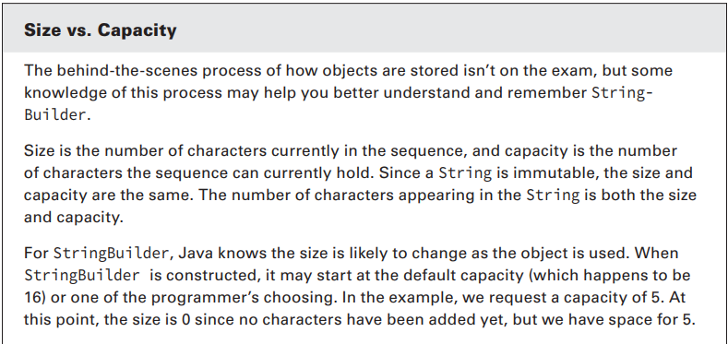
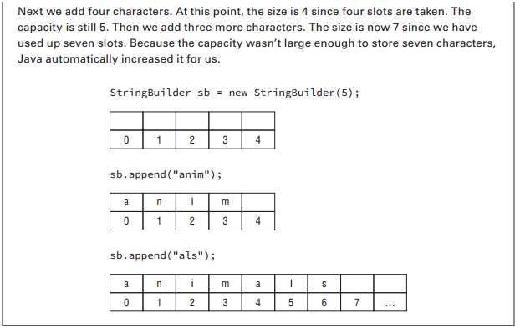
2-Using the StringBuilder Class
2-Creating a StringBuilder

Slide 36
2-Using the StringBuilder Class
3- Important StringBuilder Methods As with String, we aren’t going to cover every single method in the StringBuilder class. These are the ones you might see on the exam. charAt(), indexOf(), length(), and substring() These four methods work exactly the same as in the String class. Be sure you can identify the output of this example: StringBuilder sb = new StringBuilder("animals"); String sub = sb.substring(sb.indexOf("a"), sb.indexOf("al")); int len = sb.length(); char ch = sb.charAt(6); System.out.println(sub + " " + len + " " + ch); The correct answer is anim 7 s.

Slide 37
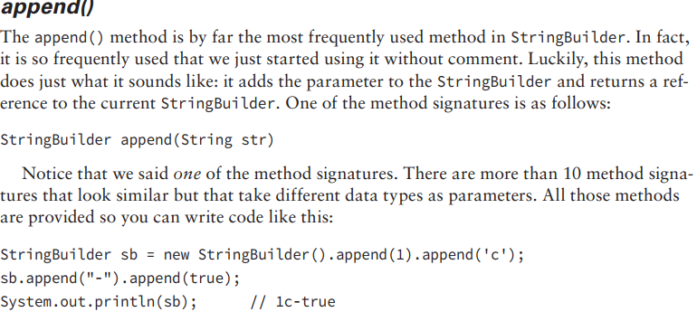
2-Using the StringBuilder Class
3- Important StringBuilder Methods

Slide 38
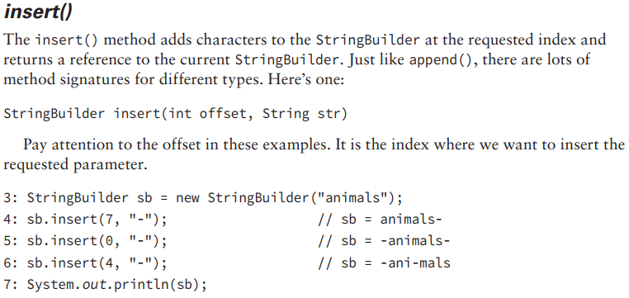
2-Using the StringBuilder Class
3- Important StringBuilder Methods

Slide 39
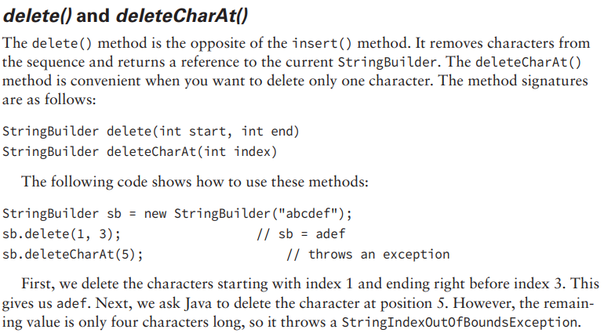
2-Using the StringBuilder Class
3- Important StringBuilder Methods

Slide 40
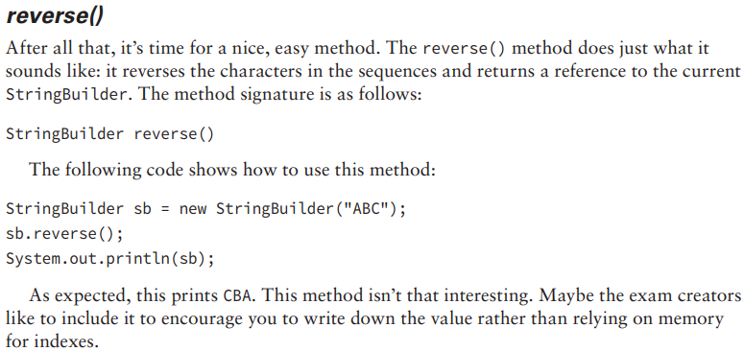
2-Using the StringBuilder Class
3- Important StringBuilder Methods

Slide 41
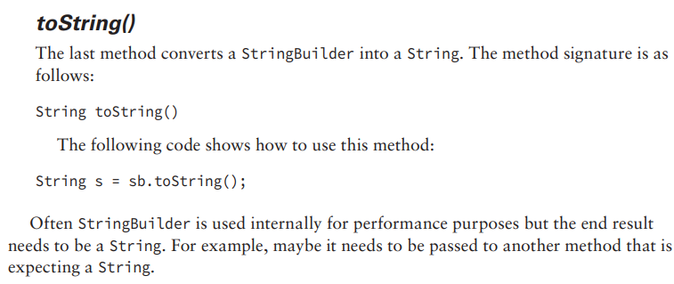
2-Using the StringBuilder Class
3- Important StringBuilder Methods

Slide 42
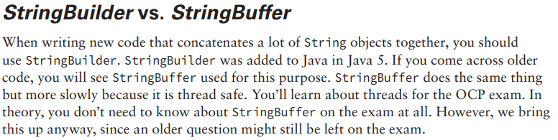
2-Using the StringBuilder Class
4- StringBuilder vs. StringBuffer

Slide 43
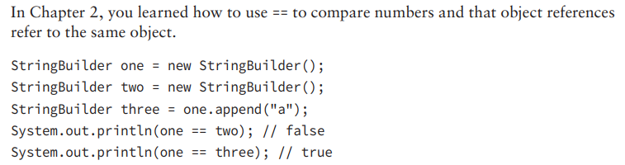
3- Understanding Equality

Slide 44
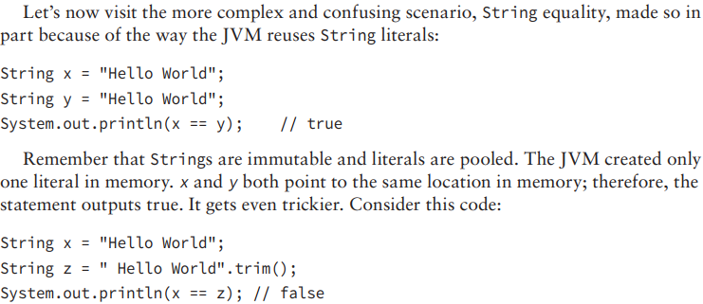
3- Understanding Equality

Slide 45
3- Understanding Equality
In this example, we don’t have two of the same String literal. Although x and z happen to evaluate to the same string, one is computed at runtime. Since it isn’t the same at compile-time, a new String object is created. You can even force the issue by creating a new String: String x = new String("Hello World"); String y = "Hello World"; System.out.println(x == y); // false Since you have specifically requested a different String object, the pooled value isn’t shared.

Slide 46
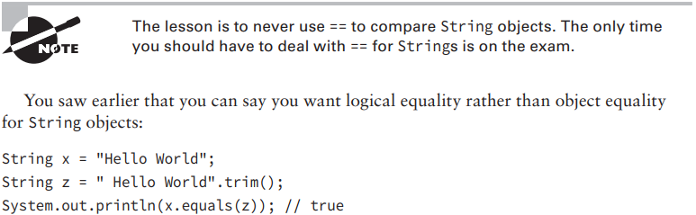
3- Understanding Equality

Slide 47
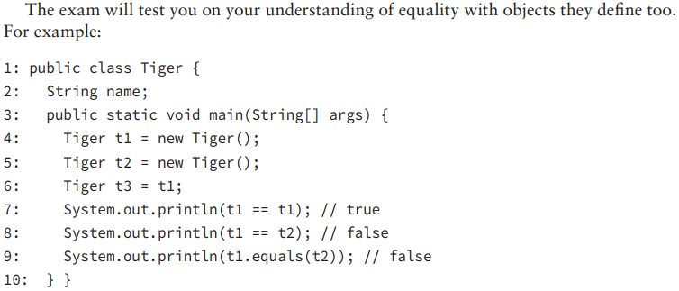
3- Understanding Equality

Slide 48
4- Understanding Java Arrays
Up to now, we’ve been referring to the String and StringBuilder classes as a “sequence of characters.” This is true. They are implemented using an array of characters. An array is an area of memory on the heap with space for a designated number of elements. A String is implemented as an array with some methods that you might want to use when dealing with characters specifically.
A StringBuilder is implemented as an array where the array object is replaced with a new bigger array object when it runs out of space to store all the characters. A big difference is that an array can be of any other Java type.
If we didn’t want to use a String for some reason, we could use an array of char primitives directly: char[] letters;

Slide 49
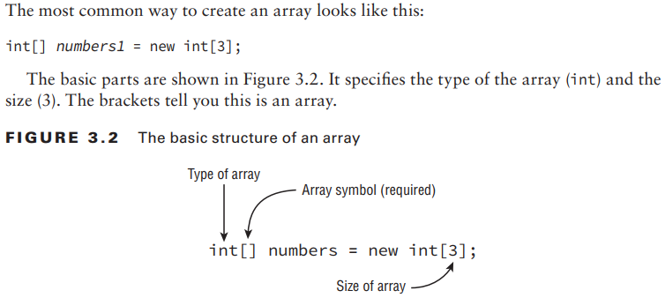
4- Understanding Java Arrays
4-1- Creating an Array of Primitives

Slide 50
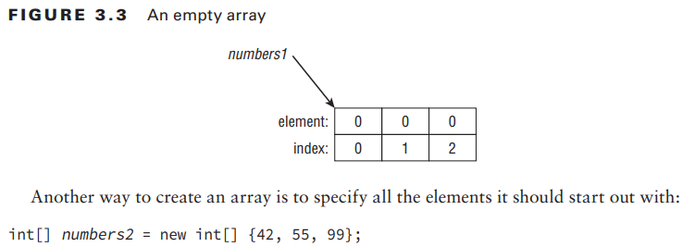
4- Understanding Java Arrays
4-1- Creating an Array of Primitives

Slide 51
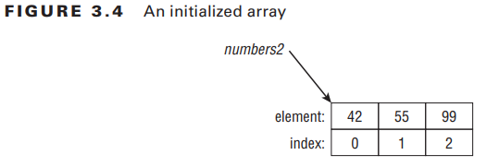
4- Understanding Java Arrays
4-1- Creating an Array of Primitives

Slide 52
4- Understanding Java Arrays
4-1- Creating an Array of Primitives Finally, you can type the [] before or after the name, and adding a space is optional. This means that all four of these statements do the exact same thing: int[] numAnimals; int [] numAnimals2; int numAnimals3[]; int numAnimals4 [];

Slide 53
4- Understanding Java Arrays
4-1- Creating an Array of Primitives You can choose any Java type to be the type of the array. This includes classes you create yourself. Let’s take a look at a built-in type with String: public class ArrayType { public static void main(String args[]) { String [] bugs = { "cricket", "beetle", "ladybug" }; String [] alias = bugs; System.out.println(bugs.equals(alias)); // true System.out.println(bugs.toString()); // [Ljava.lang.String;@160bc7c0 } }

Slide 54
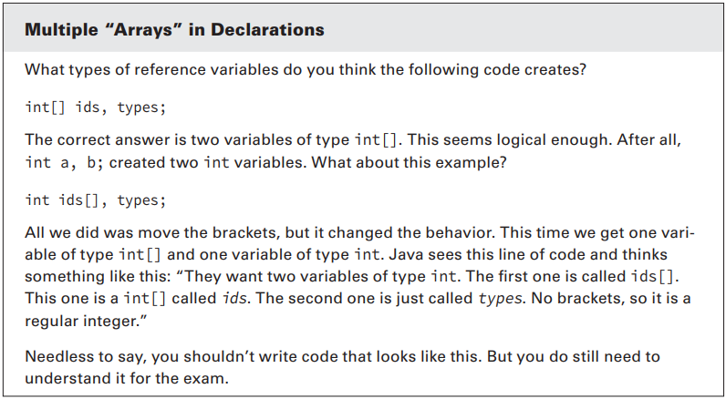
4- Understanding Java Arrays
4-1- Creating an Array of Primitives

Slide 55
4- Understanding Java Arrays
4-1- Creating an Array of Primitives We can call equals() because an array is an object. It returns true because of reference equality. The equals() method on arrays does not look at the elements of the array. Remember, this would work even on an int[] too. int is a primitive; int[] is an object. The second print statement is even more interesting. What on earth is [Ljava.lang .String;@160bc7c0? You don’t have to know this for the exam, but [L means it is an array, java.lang.String is the reference type, and 160bc7c0 is the hash code.

Slide 56
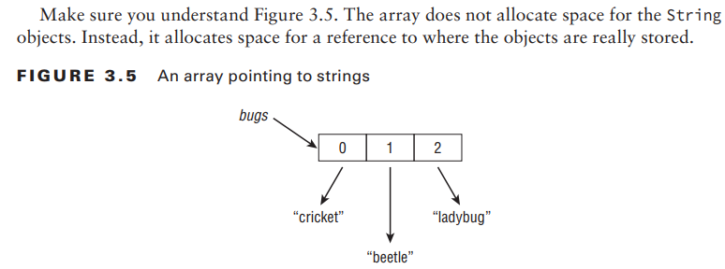
4- Understanding Java Arrays
4-1- Creating an Array of Primitives

Slide 57
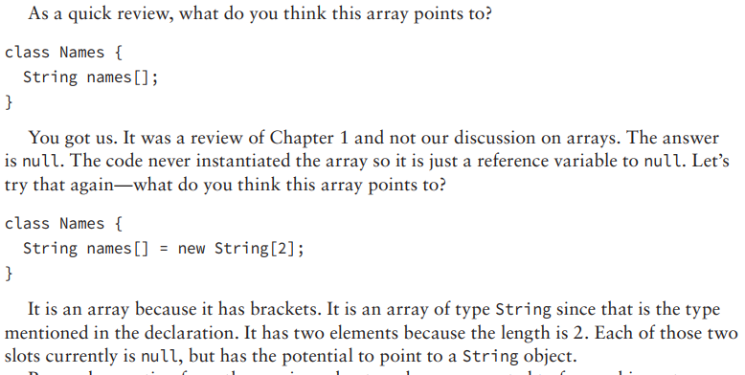
4- Understanding Java Arrays
4-1- Creating an Array of Primitives

Slide 58
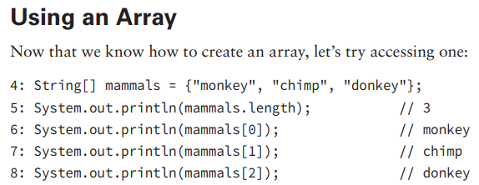
4- Understanding Java Arrays
4-2- Creating an Array with Reference Variables

Slide 59
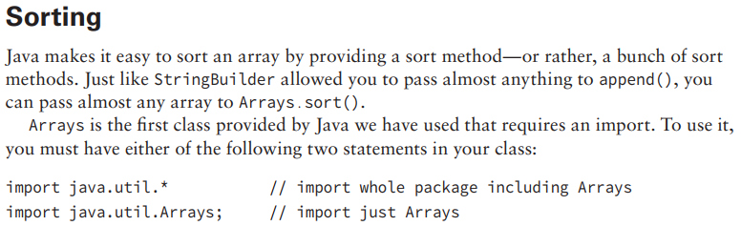
4- Understanding Java Arrays
4-2- Creating an Array with Reference Variables

Slide 60
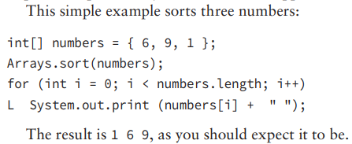
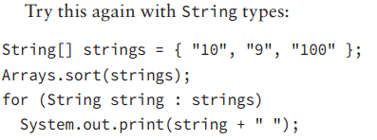
4- Understanding Java Arrays
4-2- Creating an Array with Reference Variables

Slide 61
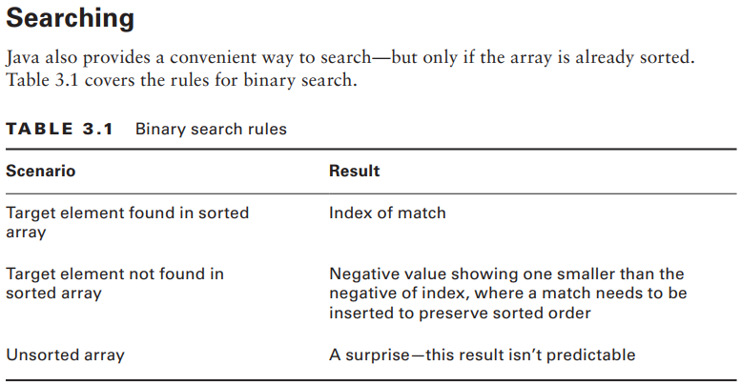
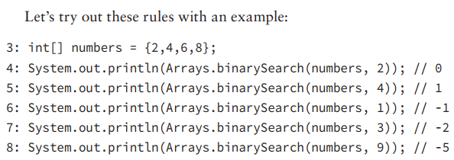
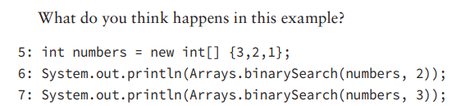
4- Understanding Java Arrays
4-1- Creating an Array of Primitives

Slide 62
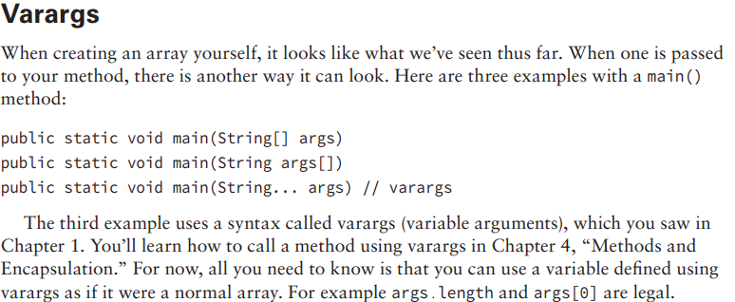
4- Understanding Java Arrays
4-2- Creating an Array with Reference Variables

Slide 63
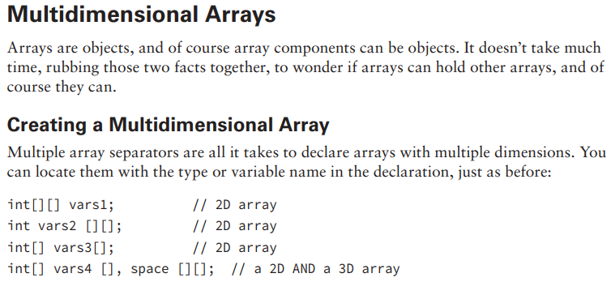
4- Understanding Java Arrays
4-2- Creating an Array with Reference Variables

Slide 64
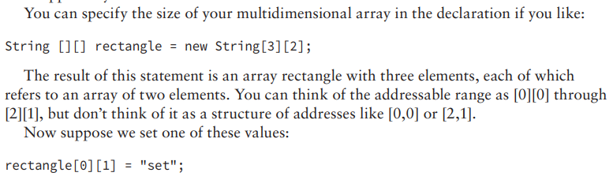
4- Understanding Java Arrays
4-2- Creating an Array with Reference Variables

Slide 65
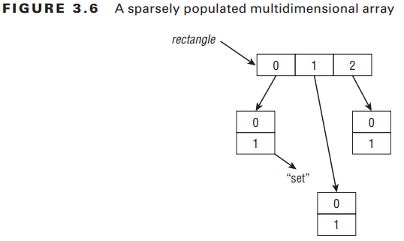
4- Understanding Java Arrays
4-2- Creating an Array with Reference Variables

Slide 66
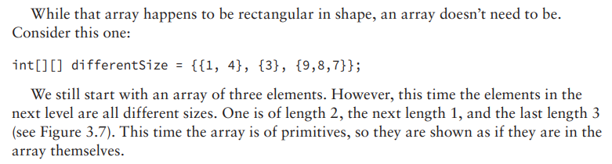
4- Understanding Java Arrays
4-2- Creating an Array with Reference Variables

Slide 67
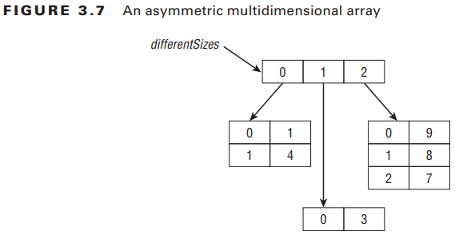
4- Understanding Java Arrays
4-2- Creating an Array with Reference Variables

Slide 68
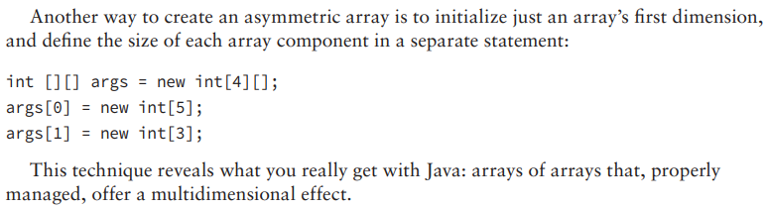
4- Understanding Java Arrays
4-2- Creating an Array with Reference Variables

Slide 69
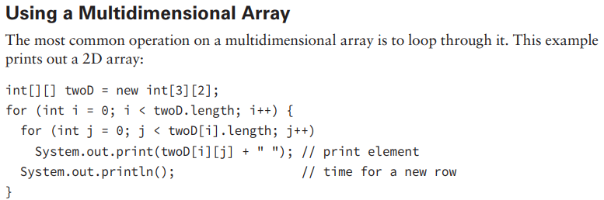
4- Understanding Java Arrays
4-2- Creating an Array with Reference Variables

Slide 70
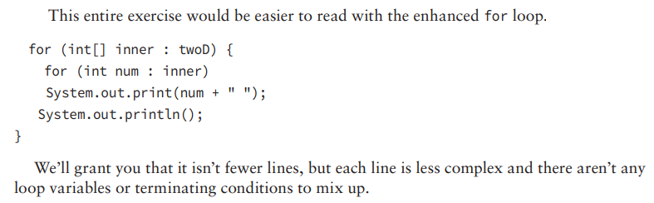
4- Understanding Java Arrays
4-2- Creating an Array with Reference Variables

Slide 71
5- Understanding an ArrayList
An array has one glaring shortcoming: you have to know how many elements will be in the array when you create it and then you are stuck with that choice. Just like a StringBuilder, ArrayList can change size at runtime as needed. Like an array, an ArrayList is an ordered sequence that allows duplicates. As when we used Arrays.sort, ArrayList requires an import. To use it, you must have either of the following two statements in your class: import java.util.* // import whole package including ArrayList import java.util.ArrayList; // import just ArrayList

Slide 72
5- Understanding an ArrayList
5-1-Creating an ArrayList As with StringBuilder, there are three ways to create an ArrayList: ArrayList list1 = new ArrayList(); ArrayList list2 = new ArrayList(10); ArrayList list3 = new ArrayList(list2); The frst says to create an ArrayList containing space for the default number of elements but not to fill any slots yet. The second says to create an ArrayList containing a specific number of slots, but again not to assign any. The final example tells Java that we want to make a copy of another ArrayList. We copy both the size and contents of that ArrayList. Granted, list2 is empty in this example so it isn’t particularly interesting.

Slide 73
5- Understanding an ArrayList
5-1-Creating an ArrayList Although these are the only three constructors you need to know, you do need to learn some variants of it. The previous examples were the old pre–Java 5 way of creating an ArrayList. They still work and you still need to know they work. You also need to know the new and improved way. Java 5 introduced generics, which allow you to specify the type of class that the ArrayList will contain. ArrayList<String> list4 = new ArrayList<String>(); ArrayList<String> list5 = new ArrayList<>();

Slide 74
5- Understanding an ArrayList
5-1-Creating an ArrayList Java 5 allows you to tell the compiler what the type would be by specifying it between < and >. Starting in Java 7, you can even omit that type from the right side. The < and > are still required, though. This is called the diamond operator because <> looks like a diamond. Just when you thought you knew everything about creating an ArrayList, there is one more thing you need to know. ArrayList implements an interface called List.

Slide 75
5- Understanding an ArrayList
5-1-Creating an ArrayList In other words, an ArrayList is a List. You will learn about interfaces in Chapter 5. In the meantime, just know that you can store an ArrayList in a List reference variable but not vice versa. The reason is that List is an interface and interfaces can’t be instantiated. List<String> list6 = new ArrayList<>(); ArrayList<String> list7 = new List<>(); // DOES NOT COMPILE

Slide 76
5- Understanding an ArrayList
5-1-Creating an ArrayList ArrayList has many methods, but you only need to know a handful of them—even fewer than you did for String and StringBuilder. Before reading any further, you are going to see something new in the method signatures: a “class” named E. Don’t worry—it isn’t really a class. E is used by convention in generics to mean “any class that this array can hold.” If you didn’t specify a type when creating the ArrayList, E means Object. Otherwise, it means the class you put between < and >. You should also know that ArrayList implements toString() so you can easily see the contents just by printing it. Arrays do not do produce such pretty output.

Slide 77
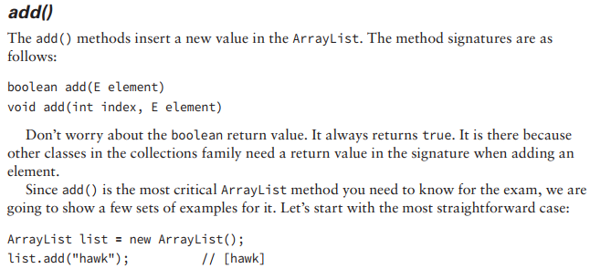
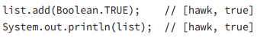
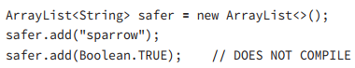
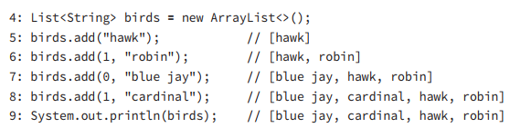
5- Understanding an ArrayList
5-2- Using an ArrayList

Slide 78


5- Understanding an ArrayList
5-2- Using an ArrayList

Slide 79
5- Understanding an ArrayList
5-3- Wrapper Classes Up to now, we’ve only put String objects in the ArrayList. What happens if we want to put primitives in? Each primitive type has a wrapper class, which is an object type that corresponds to the primitive. Table 3.2 lists all the wrapper classes along with the constructor for each.

Slide 80

5- Understanding an ArrayList
5-3- Wrapper Classes

Slide 81
5- Understanding an ArrayList
5-3- Wrapper Classes The wrapper classes also have a method that converts back to a primitive. You don’t need to know much about the constructors or intValue() type methods for the exam because autoboxing has removed the need for them (see the next section). You might encounter this syntax on questions that have been on the exam for many years. However, you just need to be able to read the code and not look for tricks in it. There are also methods for converting a String to a primitive or wrapper class. You do need to know these methods. The parse methods, such as parseInt(), return a primitive, and the valueOf() method returns a wrapper class. This is easy to remember because the name of the returned primitive is in the method name. For example:

Slide 82
5- Understanding an ArrayList
5-3- Wrapper Classes int primitive = Integer.parseInt("123"); Integer wrapper = Integer.valueOf("123"); The frst line converts a String to an int primitive. The second converts a String to an Integer wrapper class. If the String passed in is not valid for the given type, Java throwsan exception. In these examples, letters and dots are not valid for an integer value: int bad1 = Integer.parseInt("a"); // throws NumberFormatException Integer bad2 = Integer.valueOf("123.45"); // throws NumberFormatException

Slide 83
5- Understanding an ArrayList
5-3- Wrapper Classes Before you worry, the exam won’t make you recognize that the method parseInt() is used rather than parseInteger(). You simply need to be able to recognize the methods when put in front of you. Also, the Character class doesn’t participate in the parse/ valueOf methods. Since a String is made up of characters, you can just call charAt() normally. Table 3.3 lists the methods you need to recognize for creating a primitive or wrapper class object from a String. In real coding, you won’t be so concerned which is returned from each method due to autoboxing.

Slide 84

5- Understanding an ArrayList
5-3- Wrapper Classes

Slide 85
5- Understanding an ArrayList
5-4- Autoboxing Since Java 5, you can just type the primitive value and Java will convert it to the relevant wrapper class for you. This is called autoboxing. Let’s look at an example: 4: List<Double> weights = new ArrayList<>(); 5: weights.add(50.5); // [50.5] 6: weights.add(new Double(60)); // [50.5, 60.0] 7: weights.remove(50.5); // [60.0] 8: double first = weights.get(0); // 60.0

Slide 86
5- Understanding an ArrayList
5-4- Autoboxing What do you think happens if you try to unbox a null? 3: List<Integer> heights = new ArrayList<>(); 4: heights.add(null); 5: int h = heights.get(0); // NullPointerException On line 4, we add a null to the list. This is legal because a null reference can be assigned to any reference variable. On line 5, we try to unbox that null to an int primitive. This is a problem. Java tries to get the int value of null. Since calling any method on null gives a NullPointerException, that is just what we get. Be careful when you see null in relation to autoboxing

Slide 87
5- Understanding an ArrayList
5-4- Autoboxing Be careful when autoboxing into Integer. What do you think this code outputs? List<Integer> numbers = new ArrayList<>(); numbers.add(1); numbers.add(2); numbers.remove(1); System.out.println(numbers); It actually outputs 1. After adding the two values, the List contains [1, 2]. We then request the element with index 1 be removed. That’s right: index 1. Because there’s already a remove() method that takes an int parameter, Java calls that method rather than autoboxing. If you want to remove the 2, you can write numbers.remove(new Integer(2)) to force wrapper class use.

Slide 88
5- Understanding an ArrayList
5-5- Converting Between array and List You should know how to convert between an array and an ArrayList. Let’s start with turning an ArrayList into an array: 3: List<String> list = new ArrayList<>(); 4: list.add("hawk"); 5: list.add("robin"); 6: Object[] objectArray = list.toArray(); 7: System.out.println(objectArray.length); // 2 8: String[] stringArray = list.toArray(new String[0]); 9: System.out.println(stringArray.length); // 2

Slide 89
5- Understanding an ArrayList
5-5- Converting Between array and List Converting from an array to a List is more interesting. The original array and created array backed List are linked. When a change is made to one, it is available in the other. It is a fxed-size list and is also known a backed List because the array changes with it. Pay careful attention to the values here: 20: String[] array = { "hawk", "robin" }; // [hawk, robin] 21: List<String> list = Arrays.asList(array); // returns fixed size list 22: System.out.println(list.size()); // 2 23: list.set(1, "test"); // [hawk, test] 24: array[0] = "new"; // [new, test] 25: for (String b : array) System.out.print(b + " "); // new test 26: list.remove(1); // throws UnsupportedOperation Exception

Slide 90
5- Understanding an ArrayList
5-6- Sorting Sorting an ArrayList is very similar to sorting an array. You just use a different helper class: List<Integer> numbers = new ArrayList<>(); numbers.add(99); numbers.add(5); numbers.add(81); Collections.sort(numbers); System.out.println(numbers); [5, 81, 99]

Slide 91
6- Working with Dates and Times
As with an ArrayList, you need an import statement to work with the date and time classes. Most of them are in the java.time package. To use it, add this import to your program: import java.time.*; // import time classes In the following sections, we’ll look at creating, manipulating, and formatting dates and times.

Slide 92
6- Working with Dates and Times
6-1-Creating Dates and Times When working with dates and times, the frst thing to do is decide how much information you need. The exam gives you three choices: LocalDate Contains just a date—no time and no time zone. A good example of LocalDate is your birthday this year. It is your birthday for a full day regardless of what time it is. LocalTime Contains just a time—no date and no time zone. A good example of LocalTime is midnight. It is midnight at the same time every day. LocalDateTime Contains both a date and time but no time zone. A good example of LocalDateTime is “the stroke of midnight on New Year’s.” Midnight on January 2 isn’t nearly as special, and clearly an hour after midnight isn’t as special either.

Slide 93
6- Working with Dates and Times
6-1-Creating Dates and Times Oracle recommends avoiding time zones unless you really need them. Try to act as if everyone is in the same time zone when you can. If you do need to communicate across time zones, ZonedDateTime handles them. Ready to create your frst date and time objects? System.out.println(LocalDate.now()); System.out.println(LocalTime.now()); System.out.println(LocalDateTime.now()); Now that you know how to create the current date and time, let’s look at other specific dates and times. To begin, let’s create just a date with no time. Both of these examples create the same date: LocalDate date1 = LocalDate.of(2015, Month.JANUARY, 20); LocalDate date2 = LocalDate.of(2015, 1, 20);

Slide 94
6- Working with Dates and Times
6-1-Creating Dates and Times Both pass in the year, month, and date. Although it is good to use the Month constants (to make the code easier to read), you can pass the int number of the month directly. Just use the number of the month the same way you would if you were writing the date in real life. The method signatures are as follows: public static LocalDate. of(int year, int month, int dayOfMonth) public static LocalDate of(int year, Month month, int dayOfMonth) Month is a special type of class called an enum. You don’t need to know about enums on the OCA exam and can just treat them as constants.

Slide 95
6- Working with Dates and Times
6-2- Manipulating Dates and Times Adding to a date is easy. The date and time classes are immutable, just like String was. This means that we need to remember to assign the results of these methods to a reference variable so they are not lost. 12: LocalDate date = LocalDate.of(2014, Month.JANUARY, 20); 13: System.out.println(date); // 2014-01-20 14: date = date.plusDays(2); 15: System.out.println(date); // 2014-01-22 16: date = date.plusWeeks(1);

Slide 96
6- Working with Dates and Times
6-2- Manipulating Dates and Times 17: System.out.println(date); // 2014-01-29 18: date = date.plusMonths(1); 19: System.out.println(date); // 2014-02-28 20: date = date.plusYears(5); 21: System.out.println(date); // 2019-02-28

Slide 97
6- Working with Dates and Times
6-2- Manipulating Dates and Times This code is nice because it does just what it sounds like. We start out with January 20, 2014. On line 14, we add two days to it and reassign it to our reference variable. On line 16, we add a week. This method allows us to write clearer code than plusDays(7). Now date is January 29, 2014. On line 18, we add a month. This would bring us to February 29, 2014. However, 2014 is not a leap year. (2012 and 2016 are leap years.) Java is smart enough to realize February 29, 2014 does not exist and gives us February 28, 2014 instead. Finally, line 20 adds five years.

Slide 98
6- Working with Dates and Times
6-2- Manipulating Dates and Times There are also nice easy methods to go backward in time. This time, let’s work with LocalDateTime. 22: LocalDate date = LocalDate.of(2020, Month.JANUARY, 20); 23: LocalTime time = LocalTime.of(5, 15); 24: LocalDateTime dateTime = LocalDateTime.of(date, time); 25: System.out.println(dateTime); // 2020-01-20T05:15 26: dateTime = dateTime.minusDays(1); 27: System.out.println(dateTime); // 2020-01-19T05:15 28: dateTime = dateTime.minusHours(10); 29: System.out.println(dateTime); // 2020-01-18T19:15 30: dateTime = dateTime.minusSeconds(30); 31: System.out.println(dateTime); // 2020-01-18T19:14:30

Slide 99
6- Working with Dates and Times
6-2- Manipulating Dates and Times Line 25 prints the original date of January 20, 2020 at 5:15 a.m. Line 26 subtracts a full day, bringing us to January 19, 2020 at 5:15 a.m. Line 28 subtracts 10 hours, showing that the date will change if the hours cause it to and brings us to January 18, 2020 at 19:15 (7:15 p.m.). Finally, line 30 subtracts 30 seconds. We see that all of a sudden the display value starts displaying seconds. Java is smart enough to hide the seconds and nanoseconds when we aren’t using them.

Slide 100
6- Working with Dates and Times
6-2- Manipulating Dates and Times It is common for date and time methods to be chained. For example, without the print statements, the previous example could be rewritten as follows: LocalDate date2 = LocalDate.of(2020, Month.JANUARY, 20); LocalTime time = LocalTime.of(5, 15); LocalDateTime dateTime = LocalDateTime.of(date2, time) .minusDays(1).minusHours(10).minusSeconds(30);

Slide 101
6- Working with Dates and Times
6-2- Manipulating Dates and Times When you have a lot of manipulations to make, this chaining comes in handy. There are two ways the exam creators can try to trick you. What do you think this prints? LocalDate date = LocalDate.of(2020, Month.JANUARY, 20); date.plusDays(10); System.out.println(date); It prints January 20, 2020. Adding 10 days was useless because we ignored the result. Whenever you see immutable types, pay attention to make sure the return value of a method call isn’t ignored. The exam also may test to see if you remember what each of the date and time objects includes. Do you see what is wrong here?

Slide 102
6- Working with Dates and Times
6-2- Manipulating Dates and Times LocalDate date = LocalDate.of(2020, Month.JANUARY, 20); date = date.plusMinutes(1); // DOES NOT COMPILE LocalDate does not contain time. This means you cannot add minutes to it. This can be tricky in a chained sequence of additions/subtraction operations, so make sure you know which methods in Table 3.4 can be called on which of the three objects.

Slide 103

6- Working with Dates and Times
6-2- Manipulating Dates and Times

Slide 104

6- Working with Dates and Times
6-3- Working with Periods
This code works fine. It adds a month to the date until it hits the end date. The problem is that this method can’t be reused.

Slide 105

6- Working with Dates and Times
6-3- Working with Periods
Luckily, Java has a Period class that we can pass in. This code does the same thing as the previous example:

Slide 106
6- Working with Dates and Times
6-3- Working with Periods There are five ways to create a Period class: Period annually = Period.ofYears(1); // every 1 year Period quarterly = Period.ofMonths(3); // every 3 months Period everyThreeWeeks = Period.ofWeeks(3); // every 3 weeks Period everyOtherDay = Period.ofDays(2); // every 2 days Period everyYearAndAWeek = Period.of(1, 0, 7); // every year and 7 days You cannot chain methods when creating a Period, . Only the last method is used Period wrong = Period.ofYears(1).ofWeeks(1); // every week

Slide 107

6- Working with Dates and Times
6-3- Working with Periods The last thing to know about Period is what objects it can be used with. Let’s look at some code:

Slide 108
6- Working with Dates and Times
6-4- Formatting Dates and Times The date and time classes support many methods to get data out of them: LocalDate date = LocalDate.of(2020, Month.JANUARY, 20); System.out.println(date.getDayOfWeek()); // MONDAY System.out.println(date.getMonth()); // JANUARY System.out.println(date.getYear()); // 2020 System.out.println(date.getDayOfYear()); // 20

Slide 109
6- Working with Dates and Times
6-4- Formatting Dates and Times Unlike the LocalDateTime class, DateTimeFormatter can be used to format any type of date and/or time object. What changes is the format. DateTimeFormatter is in the package java.time.format. LocalDate date = LocalDate.of(2020, Month.JANUARY, 20); LocalTime time = LocalTime.of(11, 12, 34); LocalDateTime dateTime = LocalDateTime.of(date, time);
System.out.println(date.format(DateTimeFormatter.ISO_LOCAL_DATE)); System.out.println(time.format(DateTimeFormatter.ISO_LOCAL_TIME)); System.out.println(dateTime.format(DateTimeFormatter.ISO_LOCAL_DATE_TIME));

Slide 110
6- Working with Dates and Times
6-4- Formatting Dates and Times ISO is a standard for dates. The output of the previous code looks like this: 2020-01-20 11:12:34 2020-01-20T11:12:34 This is a reasonable way for computers to communicate, but probably not how you want to output the date and time in your program. Luckily there are some predefined formats that are more useful:

Slide 111
6- Working with Dates and Times
6-4- Formatting Dates and Times DateTimeFormatter shortDateTime = DateTimeFormatter.ofLocalizedDate(FormatStyle.SHORT);
System.out.println(shortDateTime.format(dateTime)); // 1/20/20 System.out.println(shortDateTime.format(date)); // 1/20/20 System.out.println( shortDateTime.format(time)); // UnsupportedTemporalTypeException The following statements print exactly the same thing as the previous code:

Slide 112
6- Working with Dates and Times
6-4- Formatting Dates and Times DateTimeFormatter shortDateTime = DateTimeFormatter.ofLocalizedDate(FormatStyle.SHORT); System.out.println(dateTime.format(shortDateTime)); System.out.println(date.format(shortDateTime)); System.out.println(time.format(shortDateTime));
In this book, we’ll change around the orders to get you used to seeing it both ways. Table 3.5 shows the legal and illegal localized formatting methods

Slide 113

6- Working with Dates and Times
6-4- Formatting Dates and Times

Slide 114

6- Working with Dates and Times
6-4- Formatting Dates and Times

Slide 115

6- Working with Dates and Times
6-4- Formatting Dates and Times

Slide 116

6- Working with Dates and Times
6-5- Parsing Dates and Times

